Slide 1
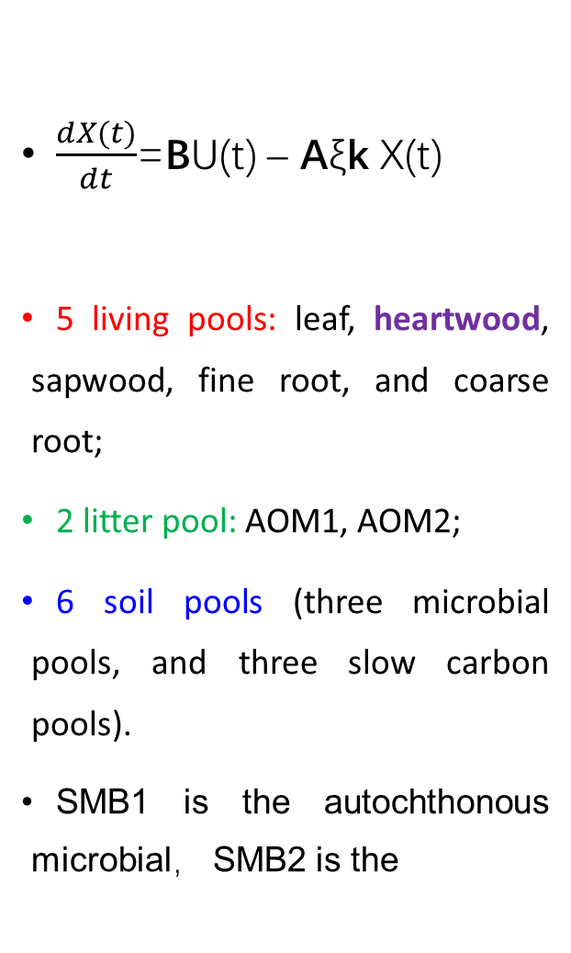
$\frac{dX(t)}{dt}$=BU(t) – Aξk X(t)
5 living pools: leaf, heartwood, sapwood, fine root, and coarse root;
2 litter pool: AOM1, AOM2;
6 soil pools (three microbial pools, and three slow carbon pools).
SMB1 is the autochthonous microbial， SMB2 is the

Slide 2

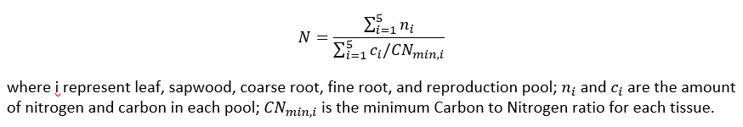
Vector B represents carbon allocation into leaf, sapwood, fine root and coarse root pools. The partition coefficients are defined with different plant functional types (PFT)
epa
leaf
No limitation: B2=0.4, B1=0.3
With limitation:
ρ is 1-B1-B2, σ is B2.
L is light availability scalar:
L=exp⁡(-k×LAI), k=0.5
W is soil moisture scalar:
N is nitrogen availability scalar:
B=
sw
fr
cr
AOM1
AOM2
SB1
SR
SB2
NM
DM
PSM

Slide 3
Matrix A is the carbon transfer matrix among different pools:
leaf
sw
fr
cr
AOM1
AOM2
SB1
SR
SB2
NM
DM
PSM
leaf sw fr cr AOM1 AOM2 SB1 SR SB2 NM DM PSM

Slide 4
Matrix A is the carbon transfer matrix among different pools:
leaf
sw
fr
cr
epa
AOM1
AOM2
SB1
SR
SB2
NM
DM
PSM
leaf sw fr cr AOM1 AOM2 SB1 SR SB2 NM DM PSM

Slide 5
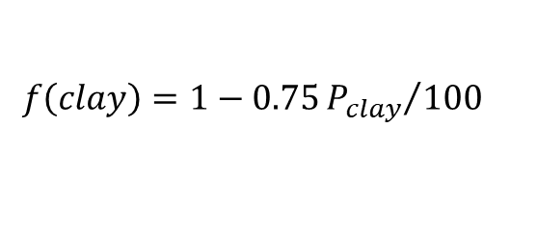
Matrix k represents the potential turnover rates in each pools:
leaf
sw
fr
cr
AOM1
AOM2
SB1
SR
SB2
NM
DM
PSM
leaf sw fr cr AOM1 AOM2 SB1 SR SB2 NM DM PSM
$$f\left(clay\right)=1−0.75{P_{clay}}/{100}$$

Slide 6
Matrix k represents the potential turnover rates in each pools:
leaf
sw
fr
cr
AOM1
AOM2
SB1
SR
SB2
NM
DM
PSM
leaf sw fr cr AOM1 AOM2 SB1 SR SB2 NM DM PSM
$$f\left(clay\right)=1−0.75{P_{clay}}/{100}$$

Slide 7
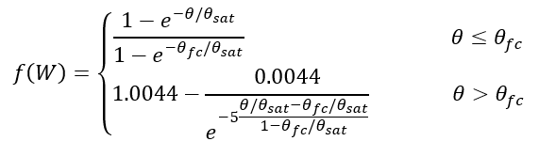
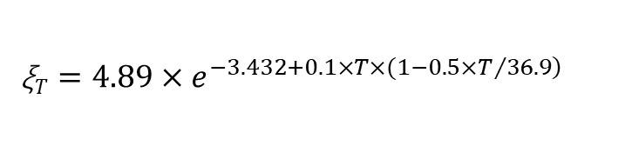
ξ represents the environmental scalar to influence the decomposition rates in each carbon pools. :
leaf
sw
fr
cr
AOM1
AOM2
SB1
SR
SB2
NM
DM
PSM
leaf sw fr cr AOM1 AOM2 SB1 SR SB2 NM DM PSM
ξ$T=4.89×e^{\left.−3.432+0.1×T×(1−0.5×T/{36.9}\right)}$

